Slide 1
Basics of java part – II
--Priyanka Gadwe

Slide 2

Contents
Basic Operators
Loop Control
Decision Making
Wrapper classes
Arrays
Regular Expressions
Java - Methods

Slide 3
1. Basic Operators
Arithmetic Operators
Assignment Operators
Logical Operators
Relational Operators
Unary Operators
Bitwise Operators
Ternary Operators
Shift Operators

Slide 4
Arithmetic Operators
Operator | Description | Example
+ Addition | Adds values on either side of the operator | A+B=30
– Subtraction | Subtracts the right-hand operator with left-hand operator | A-B=-10
* Multiplication | Multiplies values on either side of the operator | A*B=200
/ Division | Divides left hand operand with right hand operator | A/B=0
% Modulus | Divides left hand operand by right hand operand and returns remainder | A%B=0

Slide 5
Assignment Operators
Operator | Description | Example
= | Assigns values from right side operands to left side operand | c = a + b
+= | It adds right operand to the left operand and assigns the result to left operand | c += a
-= | It subtracts right operand from the left operand and assigns the result to left operand | c -= a
*= | It multiplies right operand with the left operand and assigns the result to left operand | c *= a
/= | It divides left operand with the right operand and assigns the result to left operand | c /= a
%= | It takes modulus using two operands and assigns the result to left operand | c %= a
^= | Performs exponential (power) calculation on operators and assign value to the left operand | c ^= a

Slide 6
Logical Operators
Operator | Description | Example
== | operator that compares the memory or reference location of an object in the heap | (A == B)
!= | If the values of two operands are not equal, then condition becomes true. | (A != B)
> | If the value of the left operand is greater than the value of right operand, then condition becomes true. | (a > b)
< | If the value of the left operand is less than the value of right operand, then condition becomes true. | (a < b)
>= | If the value of the left operand is greater than or equal to the value of the right operand, then condition becomes true. | (a >= b)
<= | If the value of the left operand is less than or equal to the value of right operand, then condition becomes true. | (a <= b)

Slide 7
Relational Operators
Operator | Description | Example
&& (and) | True if both the operands is true | a<10 && a<20
|| (or) | True if either of the operands is true | a<10 || a<20
! (not) | True if an operand is false (complements the operand) | !(x<10 && a<20)

Slide 8
Unary Operators
Operator | Description | Example
++ | increments the value by 1. There is post-increment and pre-increment operators | a++ and ++a
— | decrements the value by 1. There is post decrement and pre decrement operators | a– or –a
! | invert a boolean value | !a

Slide 9
public class MyClass { public static void main(String[] args){ int a = 10; System.out.println(a++++); } } (A) 11 (B) 12 (C) 13 (D) Compilation Error final int a=10 ; a++ System.out.println (a)
public class CppBuzz {
public static void main(String[] args){
int a = 10;
System.out.println(a*a++);
}
}
(A) 100 (B) 110 (C) 121 (D) compilation error
ANS – 100
ANS - Compilation Error

Slide 10
Bitwise Operators
Operator | Description | Example
& (AND) | returns bit by bit AND of input | a&b
| (OR) | returns OR of input values | a|b
^ (XOR) | returns XOR of input values | a^b
~ (Complement) | returns the one’s complement. (all bits reversed) | ~a

Slide 11
public static void main(String[] args)
{
int a = 12;
int b = 25;
System.out.println("Demonstrating & operator\n");
int c = a & b;
System.out.println(c);
}
o/p
C= 8

Slide 12
Ternary Operators
(condition ) ? (Statement 1) : (Statement 2)
value = ( 20 > 10) ? 200 : 100 ;

Slide 13
Rewrite the following using ternary operator
What will be value of X and Y
int a = 63, b = 36; boolean x = (a < b ) ? true : false; int y= (a > b ) ? a : b;
ANS - x=false y=63
if(marks >= 90)
grade = “A”;
else if( marks >= 80 )
grade = “B”;
else
grade = “C”;
ANS -grade = (mark >= 90) ? “A” : (mark >= 80) ? “B” : “C”;
if(x%2 == 0)
c = ‘E’;
else
c = ‘O’;
ANS -c = (x % 2 == 0) ? ‘E’ : ‘O’;

Slide 14
Shift Operators
Operator | Description
<< | The left shift operator moves all bits by a given number of bits to the left.
>> | The right shift operator moves all bits by a given number of bits to the right.
>>> | It is the same as the signed right shift, but the vacant leftmost position is filled with 0 instead of the sign bit.

Slide 15
int number = 2;
// 2 bit left shift operation int Ans = number << 2;
the binary number 0010 (in decimal 2) becomes 1000 after shifting the bits to the left (in decimal 8).
int number = 8;
// 2 bit signed right shift
int Ans = number >> 2;
the binary number 1000 (in decimal 8) becomes 0010 after shifting the bits to the right (in decimal 2).

Slide 16
Loop Control
Sr.No. | Loop & Description
1 | while loop Repeats a statement or group of statements while a given condition is true. It tests the condition before executing the loop body.
2 | for loop Execute a sequence of statements multiple times and abbreviates the code that manages the loop variable. --For Each loop .
3 | do...while loop Like a while statement, except that it tests the condition at the end of the loop body.

Slide 17
Loop Control Statements
Sr.No. | Control Statement & Description
1 | break statement Terminates the loop or switch statement and transfers execution to the statement immediately following the loop or switch.
2 | continue statement Causes the loop to skip the remainder of its body and immediately retest its condition prior to reiterating.

Slide 18
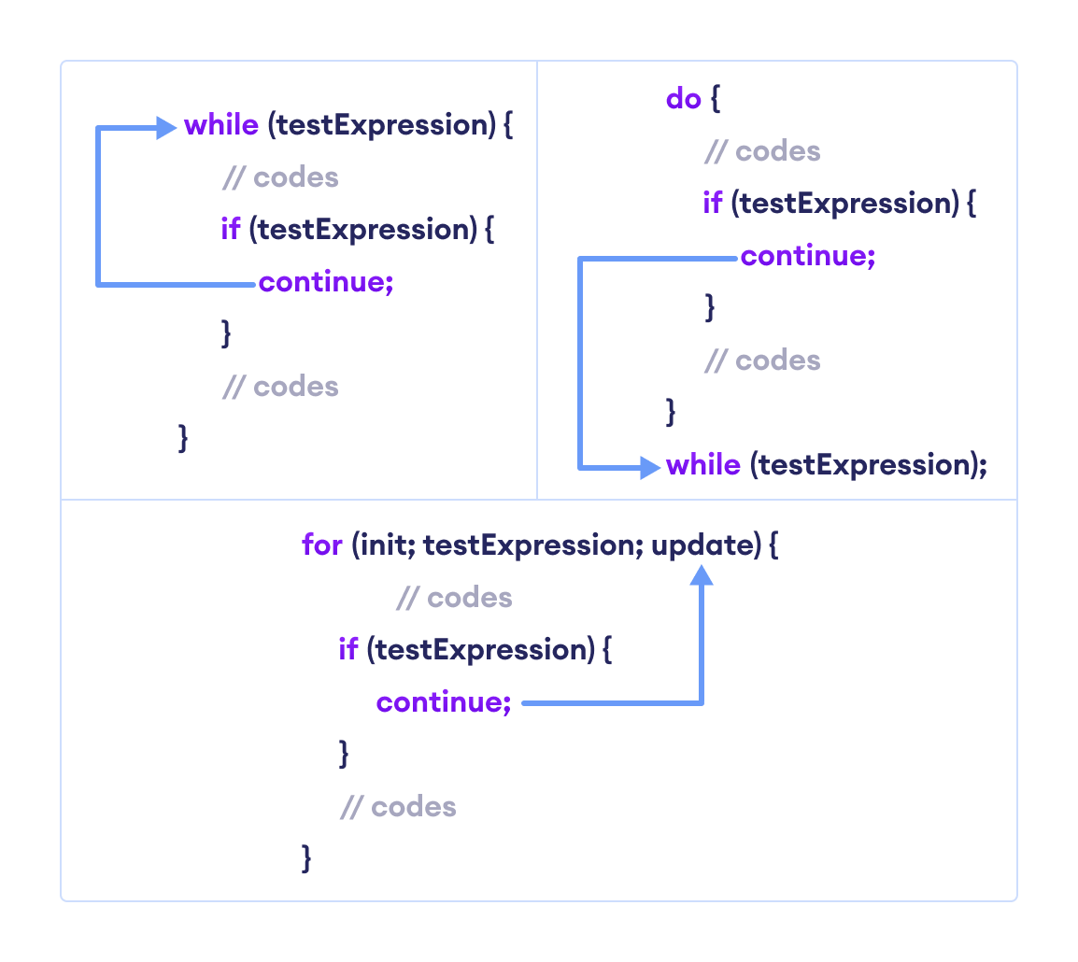
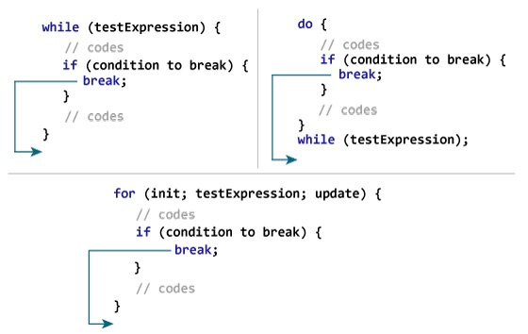

Slide 19
2. public class LabeledForExample { public static void main(String[] args) { //Using Label for outer and for loop aa: for(int i=1;i<=3;i++){ bb: for(int j=1;j<=3;j++){ if(i==2&&j==2){ break aa; } System.out.println(i+" "+j); } } } } 3. statement to execute when the value of i becomes more than 4 and less than 9.
1. public class A {
public static void main(String[] args)
{
if (true)
break;
}
a) Nothing
b) Error
ANS – Error (break outside switch or loop)
ANS –11 12,13 21
ANS - If (i>4 && i <9 ) continue ;

Slide 20
For Each loop for(declaration : expression) { // Statements }
public class ForEachEx
{
public static void main(String[] args)
{
int arr[]={12,23,44,56,78};
for(int i:arr)
{
System.out.println(i);
}
}
}

Slide 21
Decision Making
Sr.No. | Statement & Description
1 | if statement An if statement consists of a boolean expression followed by one or more statements.
2 | if...else statement An if statement can be followed by an optional else statement, which executes when the boolean expression is false.
3 | nested if statement You can use one if or else if statement inside another if or else if statement(s).
4 | switch statement A switch statement allows a variable to be tested for equality against a list of values.

Slide 22
Wrapper Class
Primitive Type | Wrapper class
boolean | Boolean
char | Character
byte | Byte
short | Short
int | Integer
long | Long
float | Float
double | Double
The wrapper class in Java provides the mechanism to convert primitive into object and object into primitive.
Collection , serialization
Since J2SE 5.0, autoboxing and unboxing feature convert primitives into objects and objects into primitives automatically.

Slide 23
Example
public class WrapperExample1 {
public static void main(String args[]) {
//Converting int into Integer
int a=20;
Integer i=Integer.valueOf(a); //converting int into Integer explicitly
Integer j=a; //autoboxing, now compiler will write Integer.valueOf(a) internally
Integer I = Integer.valueOf(10);
Double D = Double.valueOf(10.5);
Character C = Character.valueOf('a');
System.out.println(a+" "+i+" "+j);
Integer a=new Integer(3);
int i=a.intValue(); //converting Integer to int explicitly
int j=a; //unboxing, now compiler will write a.intValue() internally
}}

Slide 24
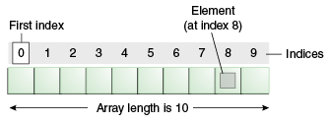
Arrays
Arrays store multiple data of similar types with the same name.
It allows random access to elements.
It is helpful to store any type of data with a fixed size.
Since the elements in the array are stored at contiguous memory locations it is easy to iterate in this data structure and unit time is required to access an element if the index is known.

Slide 25
One dimensional Array Int[] arrInt; // Array declaration
-- can we write as int[10 ] arrant
arrInt =new int [10] // memory allocation int [] age = {2,4,7.4,4} // declaration and initialization
Multidimensional Array –
Int [] [] arr = new int [10] [10]

Slide 26
Disadvantages
The size of the array should be known in advance.
Array can store only homogeneous datatype.
Insertion and deletion operations are costly in arrays as elements are stored in contiguous memory.
If the size of the declared array is more than the required size then, it can lead to memory wastage.

Slide 27
1. write a program to print sum of all even number in array
E.G Arr= {1,2,3,4,5} o/p = 6
2. take one array as an input and separate even and odd number in separate arrays

Slide 28
Regular Expressions
Expression | Description
[abc] | Find one character from the options between the brackets
[^abc] | Find one character NOT between the brackets
[0-9] | Find one character from the range 0 to 9

Slide 29
Regular Expressions
If we want to Represent a Group of Strings according to a Particular Pattern, then we
should go for Regular Expression.
Eg 1: We can write a Regular Expression to Represent All Mobile Numbers.
Eg 2: We can write a Regular Expression to Represent All Mail ID’s. aaa@bbb.xxx
Some Application Areas of Regular Expressions are
To Develop Validation Frameworks
To Develop Pattern Matching Applications (Ctrl + F in Windows, grep in UNIX)
To Develop Translators Like Compilers, Interpreters, and Assemblers Etc.

Slide 30
check if the number has ten digits and nothing else -- ^\\d{10}$
Metacharacter | Description
| | Find a match for any one of the patterns separated by | as in: cat|dog|fish
. | Find just one instance of any character
^ | Finds a match as the beginning of a string as in: ^Hello
$ | Finds a match at the end of the string as in: World$
\d | Find a digit
\s | Find a whitespace character
\b | Find a match at the beginning of a word like this: \bWORD, or at the end of a word like this: WORD\b
\uxxxx | Find the Unicode character specified by the hexadecimal number xxxx

Slide 31
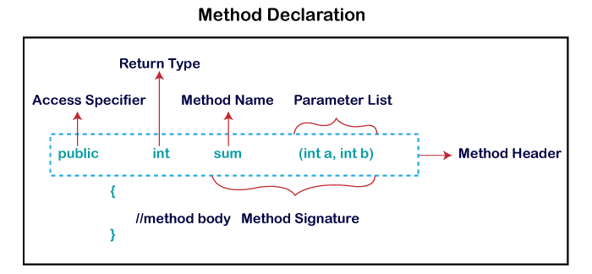
Java Methods
A method is a block of code which only runs when it is called.
You can pass data, known as parameters, into a method.
Why use methods? To reuse code: define the code once, and use it many times.

Slide 32
Assignment Questions -
1. write a program to calculate Simple interest and compound interest
2. write a program to search 2nd highest number from an array .
3.Write a program to convert currency in respective country value . (switch case)Eg – i/p X rs o/p Y$
4. Program to find highest of 3 numbers .
5. Write a program to check valid i/p pin num. format – ex. 443 122

Slide 33


